Slide 1

Computer-Aided Design of Digital Systems (CAD)
ECE381(CAD), Lecture 1:
Mehdi Modarressi
Department of Electrical and Computer Engineering,
University of Tehran

Slide 2
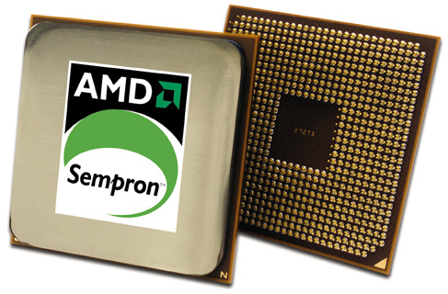
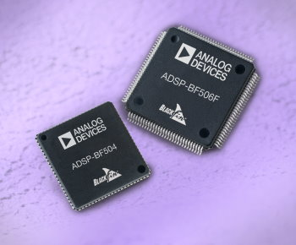
Full-custom ICs
General-purpose processors
  Example: Intel and AMD microprocessors
Application-specific processors
  Example: Embedded processor of a digital camera
Requires establishing a fabrication line
  You will learn more about this in the VLSI course

Slide 3
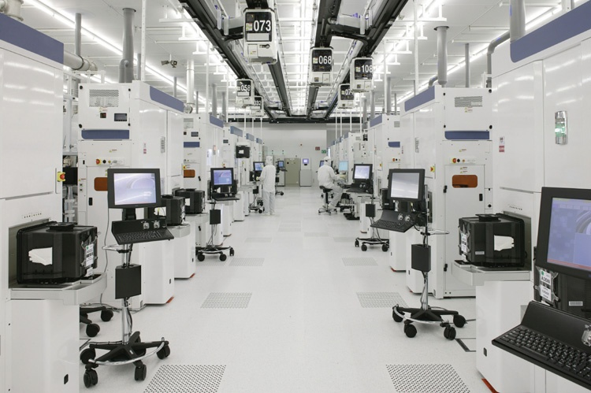
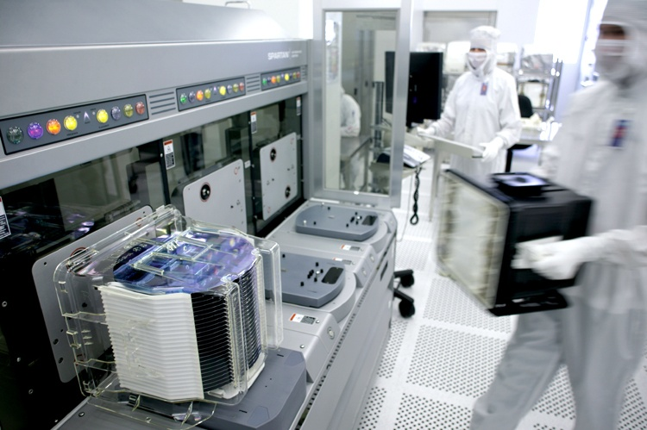
IC fabrication process
Silicon fabrication lab
AMD’s 65 nm fabrication lab (control and clean room)
Source: http://www.dailytech.com

Slide 4
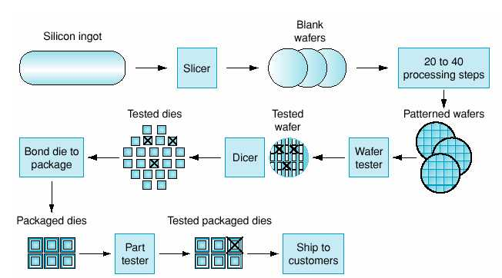
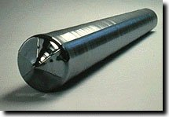
VLSI process for full custom ICs
Notes:
18

Slide 5
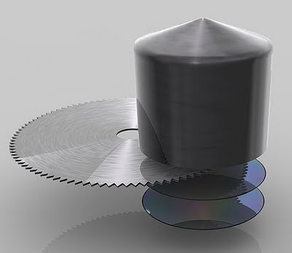
VLSI process for full custom ICs
Notes:
18

Slide 6
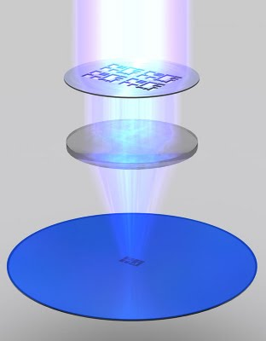
VLSI process for full custom ICs
Notes:
18

Slide 7
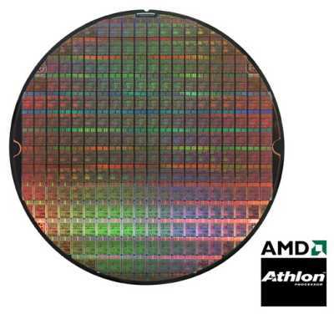
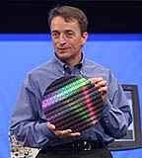
VLSI process for full custom ICs
Notes:
18

Slide 8
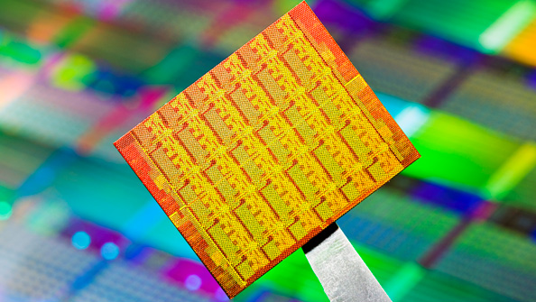
VLSI process for full custom ICs
Notes:
18

Slide 9
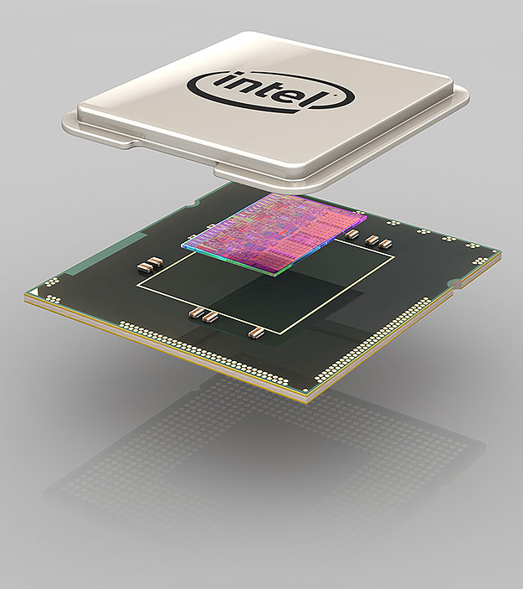
VLSI process for full custom ICs
Notes:
18

Slide 10
VLSI process for full custom ICs
Notes:
18

Slide 11
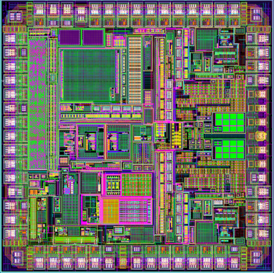
Full-custom ICs
Very efficient in terms of performance, but:
  Long design and manufacturing cycles
  Very expensive, sometimes several million dollars
  → Suitable for large volume production
  Once manufactured, the logic can’t simply be altered
    Large penalty if a bug is found

Slide 12
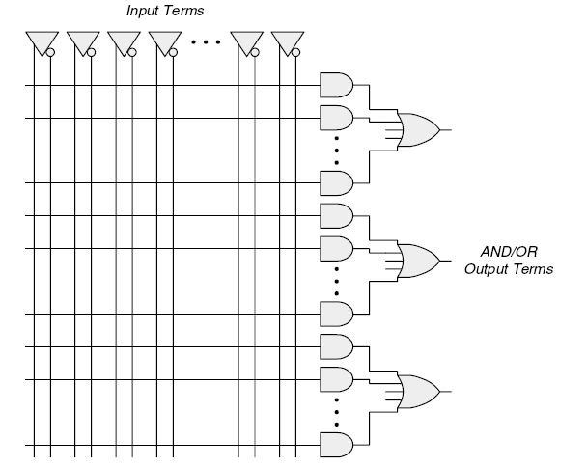
Programmable devices
You know simple PLDs from the Logic Design course
We will review them again shortly
Example: PAL
  Very simple programmable IC
  The base of more complex programmable ICs

Slide 13
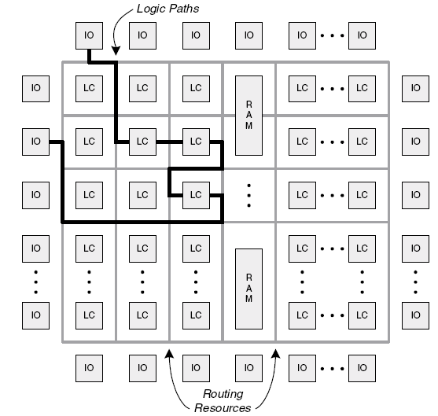
FPGA
FPGA: Filed Programmable Gate Array
  LC= logic cell, can be a PAL

Slide 14
Digital design flow for FPGAs
Design entry
Logic synthesis
Partitioning
Placement
Routing
Pin assignment
Physical Design

Slide 15
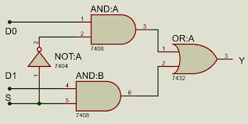
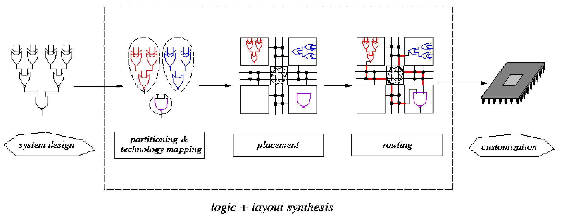
Digital design flow for FPGAs
VHDL
…..
…..
…..
Design entry
Logic synthesis
Partitioning
Placement
Routing
Physical Design (Layout Synthesis)

Slide 16
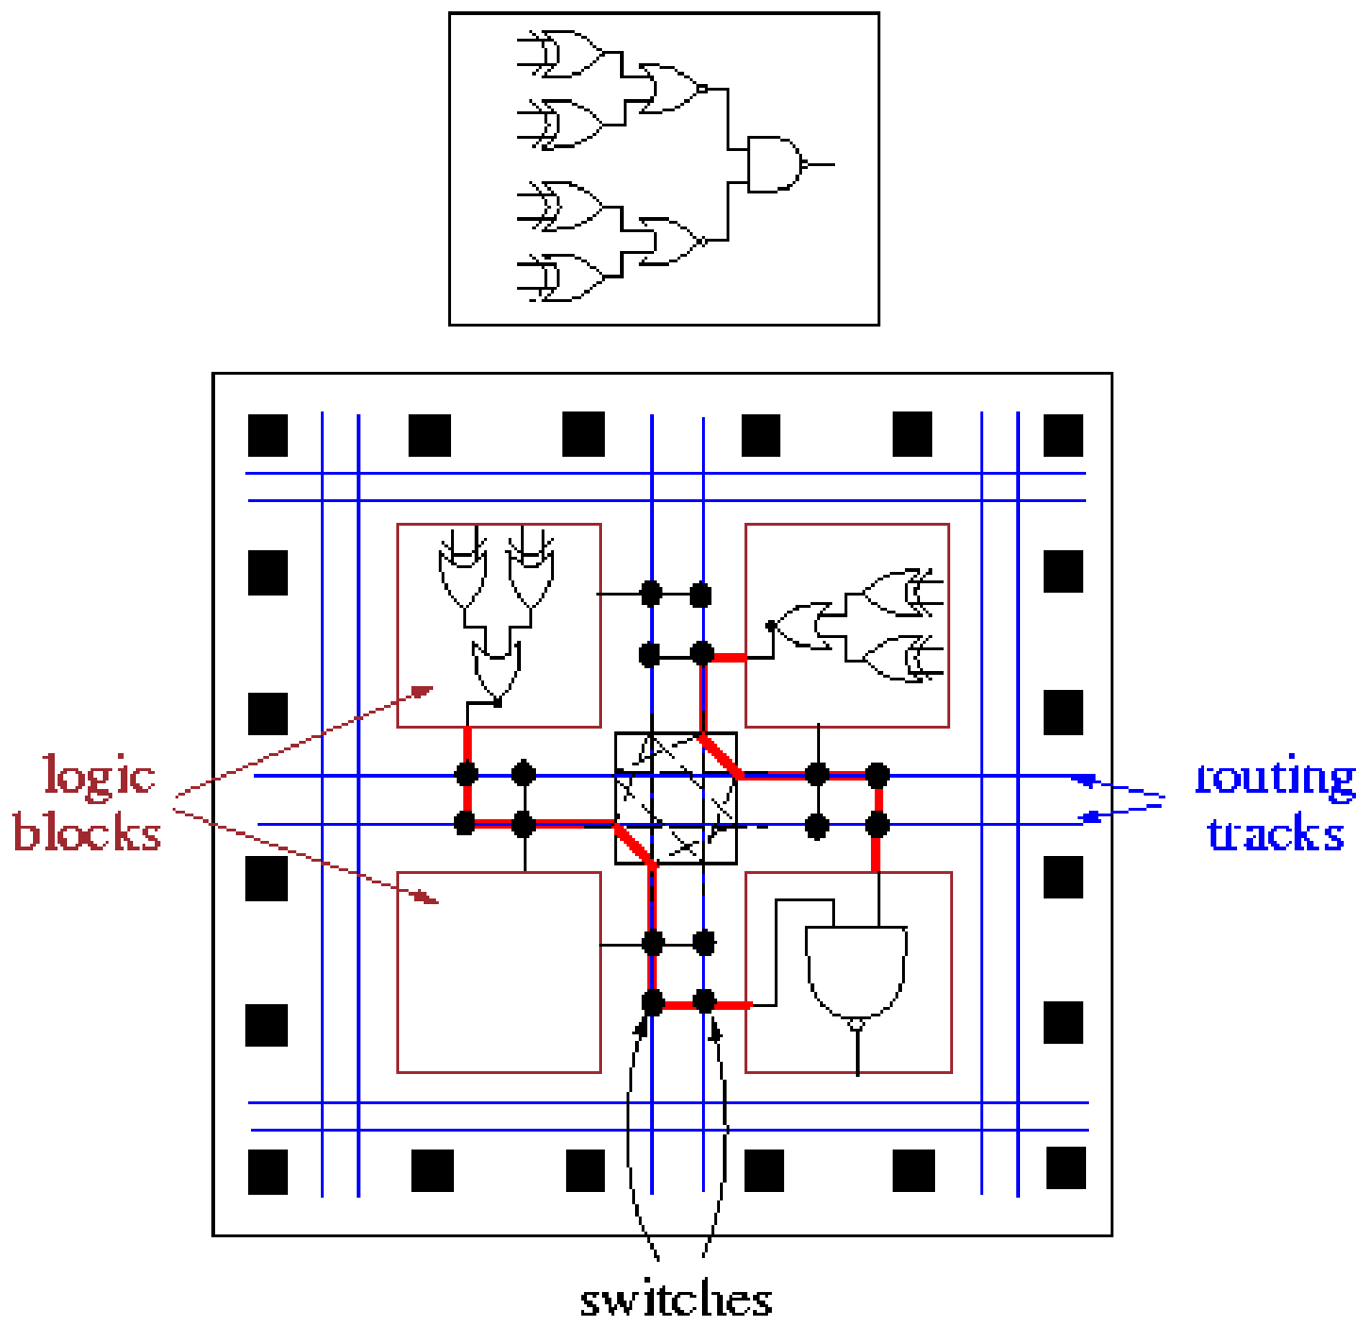
FPGA physical design

Slide 17
Synthesis objectives
Synthesized code should meet several constraints:
  Performance
  Area
  Power
  Any combination of the above
VHDL
…..
…..
…..
Synthesis tool
set of constraints

Slide 18
Why hardware design?
Embedded systems may have some non-functional requirements
Functional requirements: the system must do its job correctly and produce the right results
  Nonfunctional requirements care about how (with which quality) the work is down
    Power, performance, reliability, cost,…
  Sometimes, the best way to meet the power and speed requirements is to use hardware acceleration

Slide 19
Hardware acceleration
Acceleration: implementing an algorithm on hardware (rather than on software+CPU) to get more speed
Implementing an algorithm on hardware is 10-1000 times faster than the software implementation

Slide 20
Why acceleration?
By acceleration, we omit the software overhead that a CPU have for the sake of flexibility
  Fetch, decode, register access, ….
By acceleration, the architecture exactly match the processing pattern of the problem
Accelerator is often implemented on FPGA
  Can also be implemented on full custom design
  The architecture has more speed on full custom hardware is faster, but very hard and lengthy to build
  FPGA is more easy-to-reach and faster to design/build

Slide 21
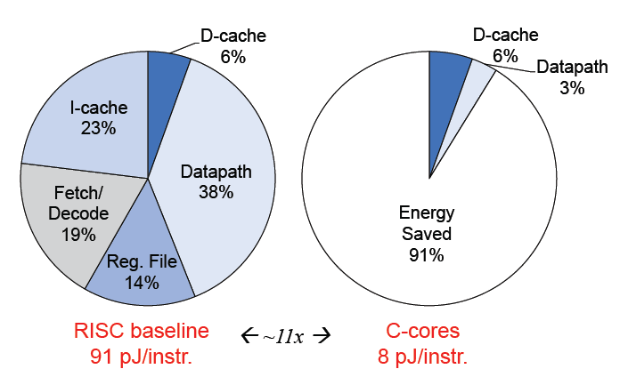
Why acceleration?
In addition to 10-1000 higher speed, hardware implementation is more energy-efficient than software implementation

Slide 22
Hardware acceleration
Accelerator can be used as
  An independent chip
    Known as ASIC (Application-Specific IC) chips
  An integrated part of a processor as a core or co-processor
    Example: the cores inside a mobile SoC

Slide 23
Hardware acceleration- ASICs
A pure accelerator chip: digital circuit designed to execute one program
Features
  Contains only the components needed to execute a single program
  No programmable, do not have the flexibility of CPUs
Benefits
  Fast (optimized)
  Low power
  Small size
ASIC can be implemented on FPGA or full-custom design (refer to the CAD course to remember the difference)

Slide 24
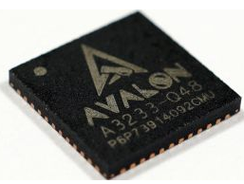
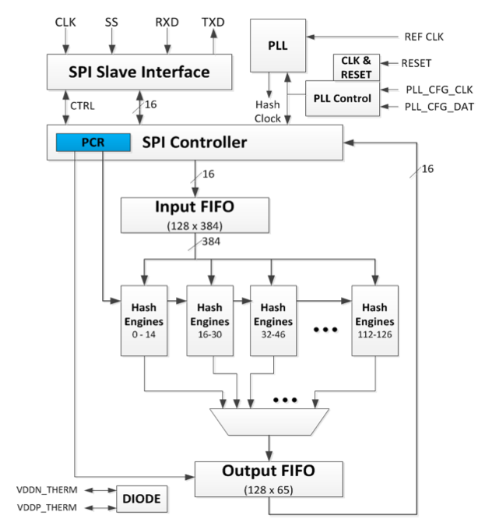
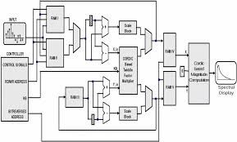
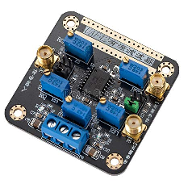
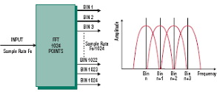
ASICs
ASICs have no instructions
  Have no software
  But they usually get parameters (e.g. the memory addresses to get input data, coefficients, data size,…) from a configuration file
All datapath and control path are hardcoded
ASIC for BitCoin mining

Slide 25
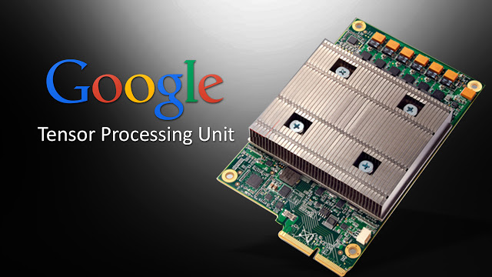
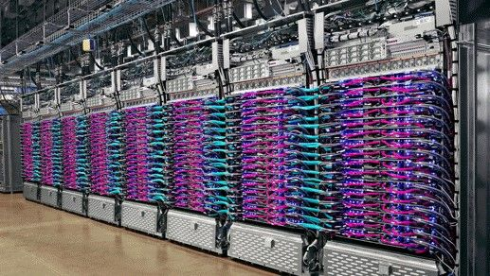
Accelerator example- Deep learning
The internal structure is customized to run large neural networks
Example: Google TPU (tensor processing unit)
Can run 64000 neurons in parallel
Used in most Google services (e.g. Google translate,…)

Slide 26
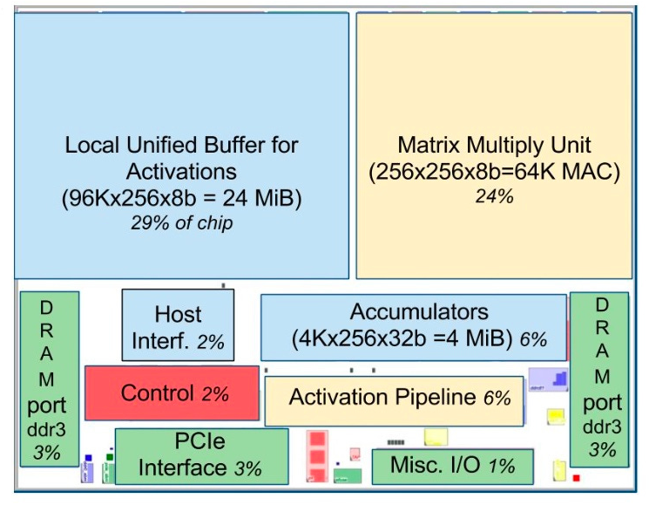
Google TPU

Slide 27
AI and Hardware accelerators
Hundreds of commercial products
Google TPU
nVidia Jetson
IBM TrueNorth
Intel Movidios
Qualcomm AI100
….

Slide 28
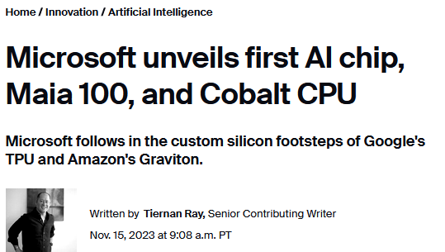
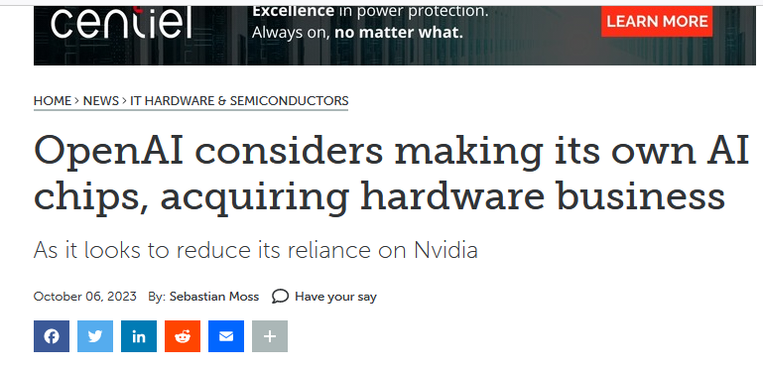
AI and Hardware accelerators

Slide 29
Accelerator-rich processors
System-on-chip
Have many accelerator cores along with the main processing cores

Slide 30
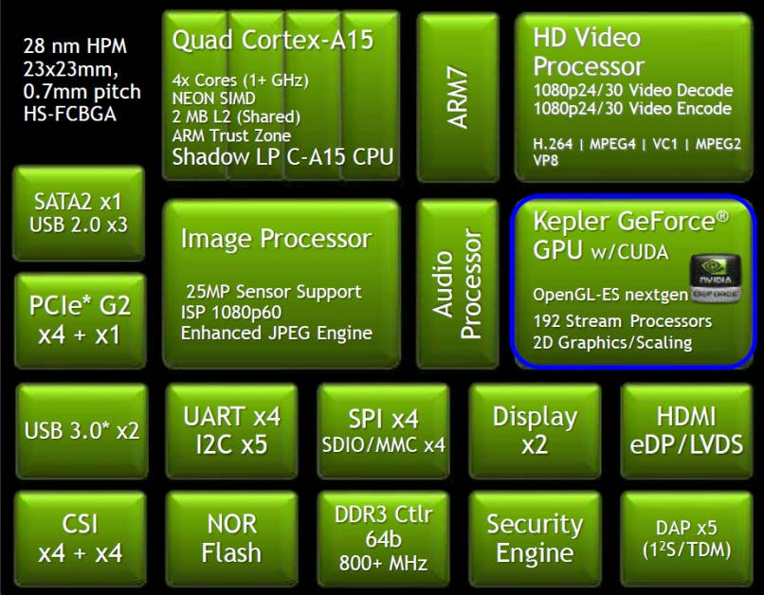
Multiprocessor system-on-chips
SoCs are the main processing part of tablets and smart phones
  Processor cores and other accelerators are integrated onto a single chip
Example: Tegra SoC by nVidia

Slide 31
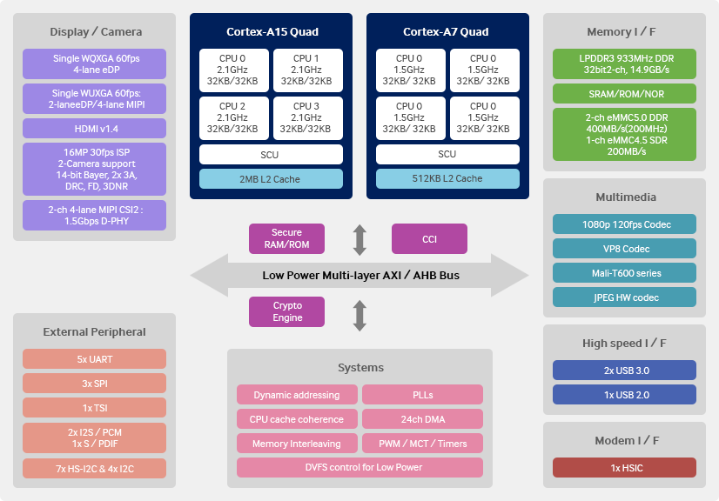
Complex SoCs- mobile processor
Some SoCs are very large and complex
  Application processor in mobiles and tablets
  Signal processing SoCs

Slide 32
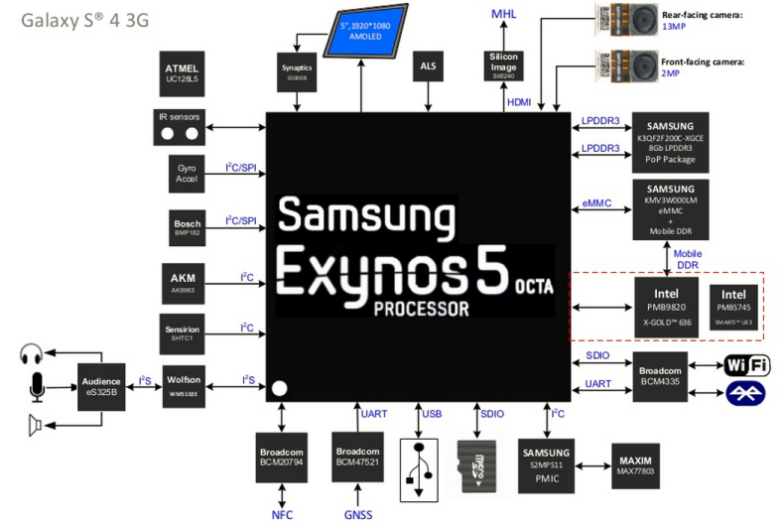
SoC in a tablet

Slide 33
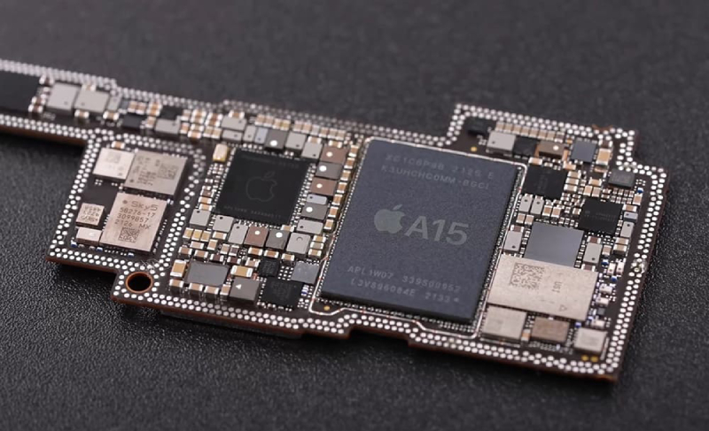
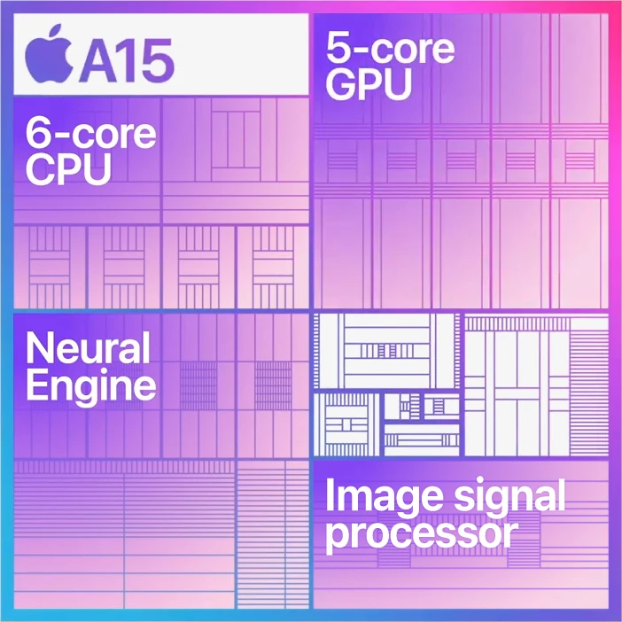
Apple A15

Slide 34
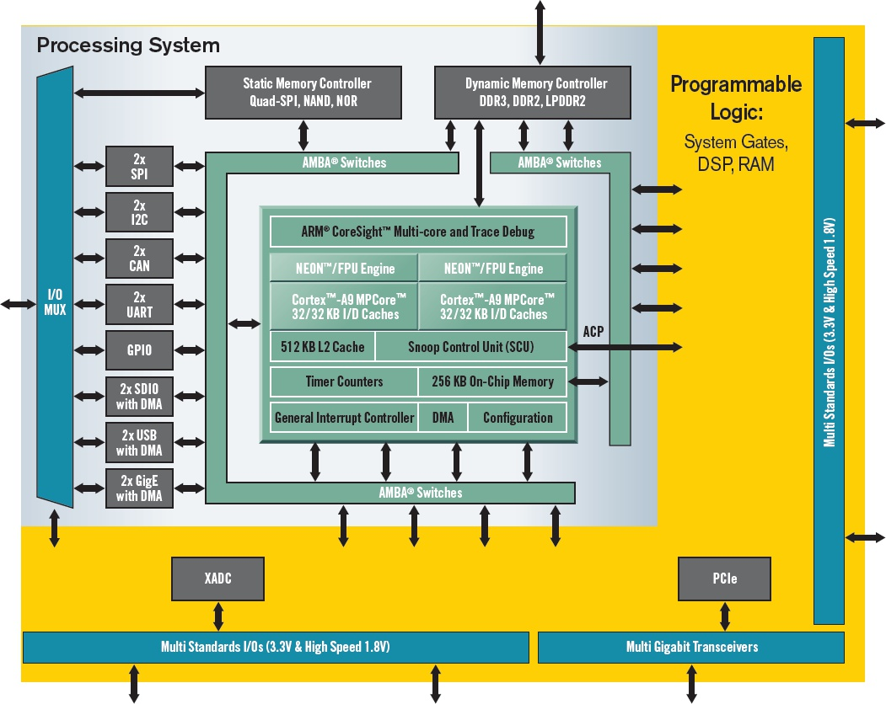
System-on-programable chip
Zynq FPGA block diagram
FPGA (yellow part) and ARM processor on the same chip

Slide 35
SoPC
System-on-Programmable Chip (SoPC): FPGA vendors provide an SoC on an FPGA chip
In addition to configurable part there are also:
  Processor cores
  Peripherals
  On-chip buses
  DSP blocks
  A rich range of soft IP cores as a library can be implemented on the configurable part
  Operating systems and software drivers
  …

Slide 36
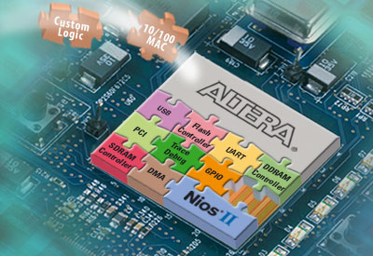
SoPC
Xilinx SoPCs:
  2 or 4 PowerPC 405 and 440 cores and many peripherals
  Xilinx EDK for development
Altera SoPCs:
  NIOS II or ARM Cortex cores and many peripherals
    ARM Cortex is a dual core processor
  Altera SoPC Builder for development
Picture source: http://www.altera.com
Notes:
The class and the labs will provide you with the opportunity to create an embedded design.

Slide 37


Altera Startix
32-bit embedded NIOS-II processor
CUSTOM
INSTR IF
TCM
I-MEM
TCM
D-MEM
I$
D$
INT
CNTRL
MMU
MPU
EXP
CNTRL
Debug
JTAG
DEBUG
HW
BP
I & D
TRCE
TRCE
PORT
FPGA
Your design here
Picture source: http://www.altera.com
Notes:
Nios has been one of Altera’s most successful products
Over 20,000 Nios Development Kits have been shipped

Slide 38
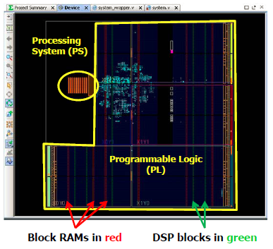
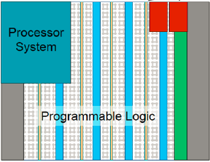
Xilinx Zynq
A modern SoPC with many hardcore logic

Slide 39
Xilinx Zynq
FPGA fabric with embedded ARM processor on single die
  Programmable logic (PL)
  Processing system (PS)
PS based on dual-core ARM Cortex-A9
  A rich set of peripherals: USB, CAN, SPI, Flash memory interface, DAM controller, memory controller, …..

Slide 40
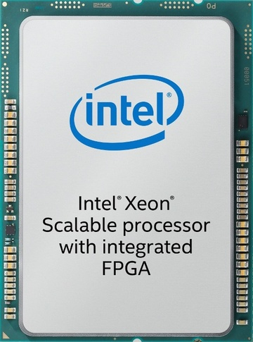
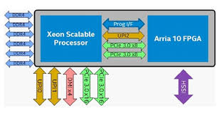
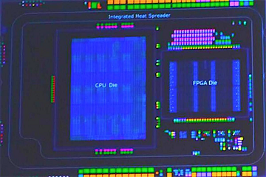
CPUs with FPGA
The latest trend initiated by Intel
A processor that has an embedded FPGA
Can be used to design customized accelerator

Slide 41
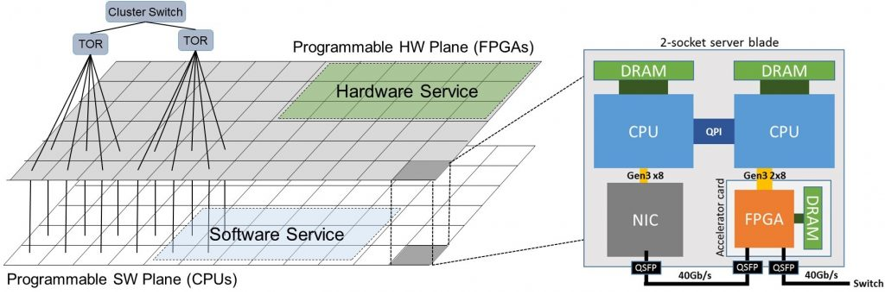
FPGA-based acceleration
Configurable Cloud in Microsoft Azure system (FPGA+CPU)
FPGA can accelerate specific computations

Slide 42
Design reuse
Using IP-cores
  “IP” means “intellectual property”
  Circuit designs cleaned up and made available to other engineers
IP examples:
  Microprocessor cores
  DSP cores
  Ethernet, USB, FireWire, 802.11 cores
  Special-purpose cores
    MPEG-2 compression, decompression, encryption cores, filters,etc…
The global semiconductor IP market was valued at $3,434 million in 2017, and is projected to reach $5,701 million by 2024

Slide 43

Open IP cores on the internet

Slide 44
Hard IP-cores
Delivered in physical form
Fully designed, placed and routed, and characterized for timing, power, etc.
Tied to a manufacturing process
Actual physical layout
  Fixed shape
Technology specific layout
  Size and speed determined

Slide 45
Soft IP-cores
Circuit design delivered in “source code” format instead of physical film or physical-layout information
  In forms of RTL code or netlist
  technology dependent gate-level netlists are called firm-core
Functions are fixed, may be parameterizable
  Size and shape are determined when synthesizing
Equivalent to delivering C source code
  The program doesn’t change at all, only the details of the executable binary you create

Slide 46
IP core generation
can be done in many commercial tools
  Xilinx CORE Generator System
  Matlab HDL Coder
We can use IP cores by some tools
  Vivado® IP Integrator from Xilinx
  Qsys from Altera

